Slide 1

SAKILA DVD RENTAL STORE
CAPSTONE PROJECT - MOVIE RENTAL ANALYTICS
Developed & Presented By Biswarup Dey

Slide 2
OBJECTIVE
The principal aim of this project is to conduct an extensive Exploratory Data Analysis (EDA) utilizing the Sakila DVD Rental Store Database. The objective is to extract valuable insights pertaining to the rental store's operations, with a specific focus on customer behavior, film rental patterns, store and inventory management, and sales growth.
This analytical endeavor is intended to provide the foundation for the development of a comprehensive Power BI dashboard, which will empower stakeholders with data-driven decision-making capabilities for rental store business. The ultimate goal is to enhance the overall business performance through optimizing film inventory, enhance customer satisfaction, improve staff performance & streamline store operations.

Slide 3

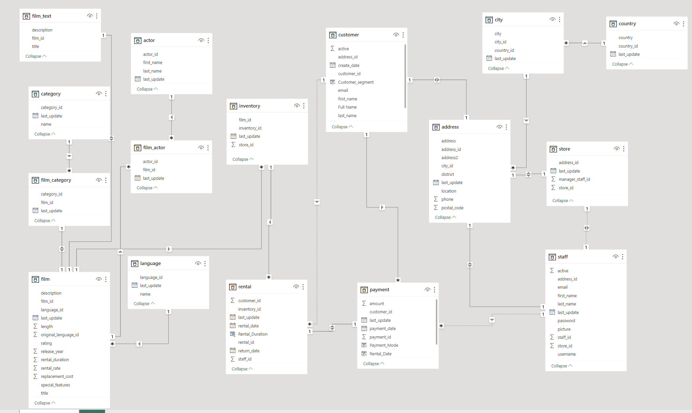
DATA MODELING

Slide 4
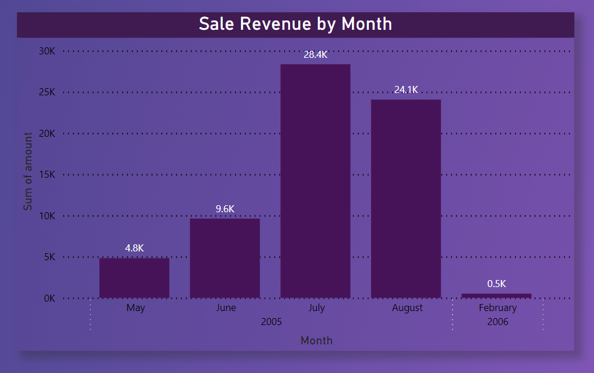
How does the sales revenue vary by month?
INSIGHT:
Sales revenue is increasing month by month starting from May till July and there is a minimal drop in August.
There is no sales record from Sept’05 to January’06
CONCLUSION:
Sakila DVD rental store business appears to have a seasonal sales pattern with stronger performance in the summer & autumn months, but there are challenges in the winter months, as seen in the absence of sales records for several months and a sharp drop in February.

Slide 5
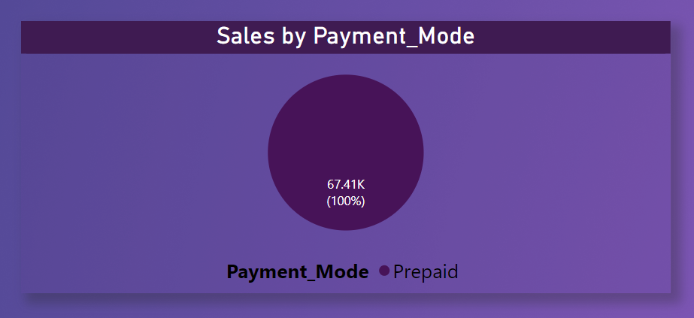
What is the distribution of sales by payment method?
INSIGHT:
100% of the payment received in prepaid mode.
CONCLUSION:
The business seems to have a specific payment model that works for its customer base, but it's important to consider whether diversifying payment options could potentially expand the customer base and increase sales.

Slide 6
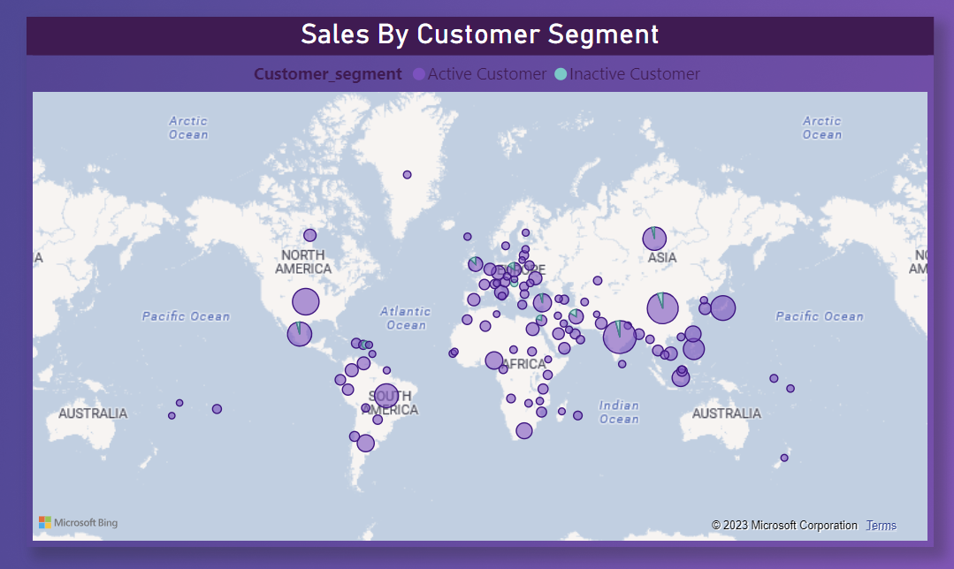
Which customer segments generate the highest sales?
NOTE:
Built a report based on customer’s location and taken how sales has been generated by different customer segments like active customer or inactive.
INSIGHT:
Active Customers of India, China & United States have generated highest sales.

Slide 7
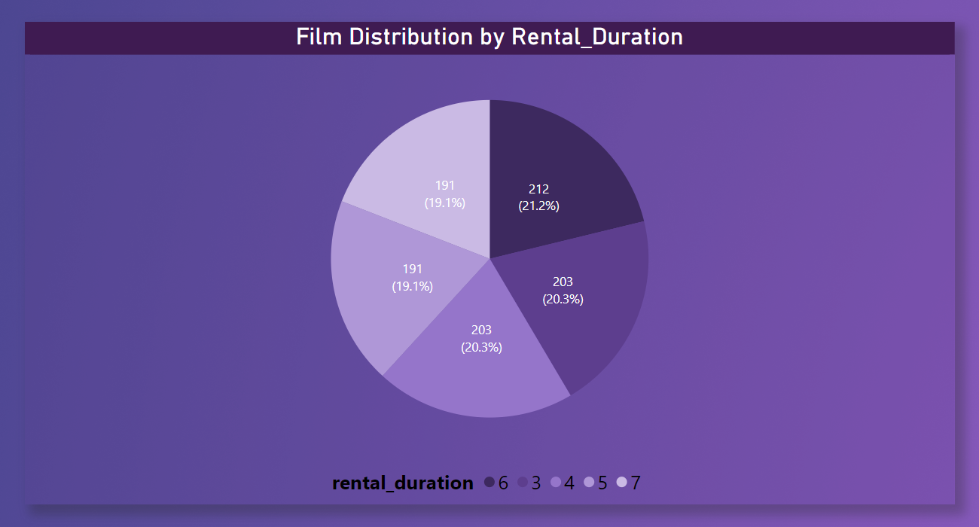
What is the distribution of films by rental duration?
INSIGHT:
The distribution of films according to the rental duration is almost 20% for all the categories. To be specific count if DVDs with rental duration of 6 days are highest in inventory.
CONCLUSION:
the almost equal distribution of films across different rental durations suggests that the store is accommodating customer preferences effectively. It's important for the store to continue providing flexibility in rental duration choices, managing inventory efficiently, and possibly considering pricing strategies to optimize its rental services.

Slide 8
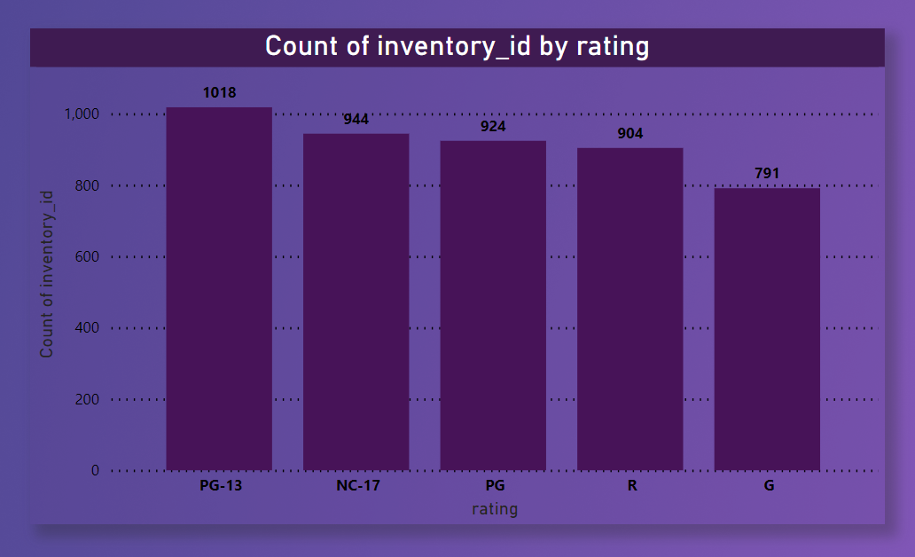
How does the inventory vary by film rating?
INSIGHT:
Collection of PG13 movies in the stores is highest among all others.
CONCLUSION:
The business emphasis on PG-13 movies suggests a strong demand for this film rating among its customers. However, it's essential to balance the inventory with a diverse selection to cater to a wider range of preferences and potentially expand the customer base.

Slide 9
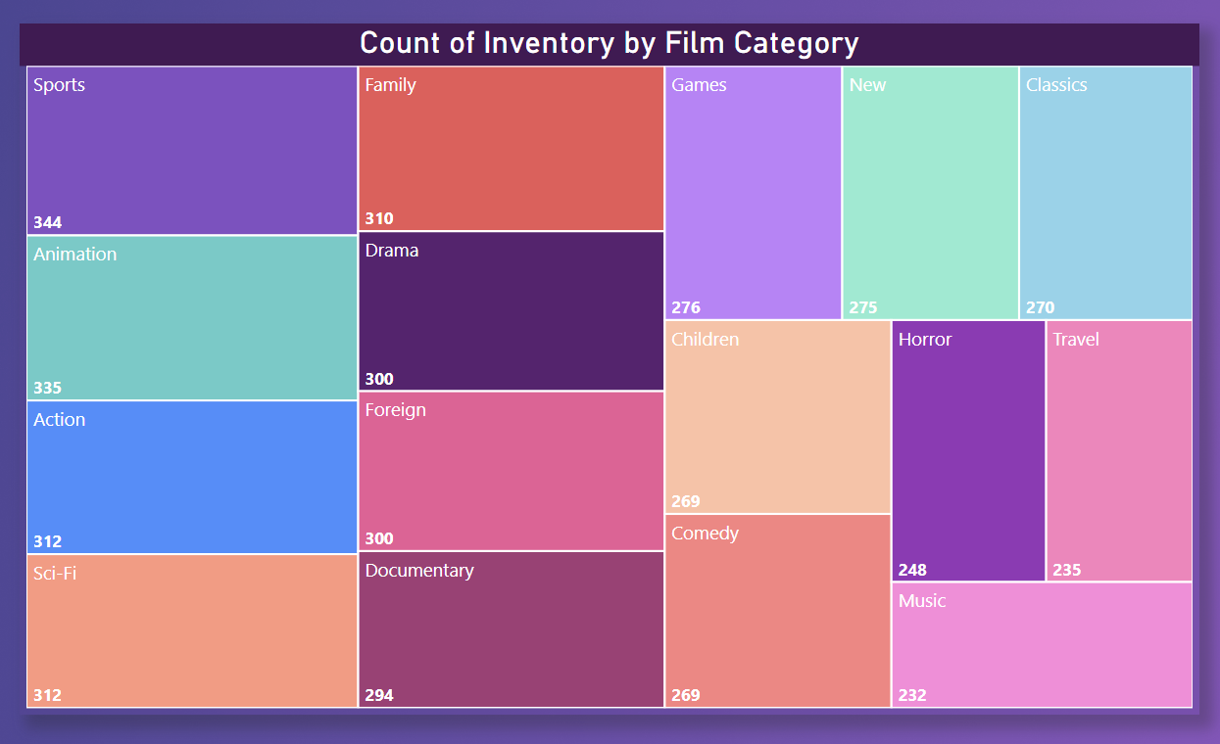
What is the breakdown of film categories in the inventory?
INSIGHT:
Maximum number of films are from sports category, followed by animation, action, sci-fi, family, drama, foreign etc.
CONCLUSION:
The company's film inventory is heavily focused on the sports category, followed by animation, action, sci-fi, family, and drama. This suggests that these categories are popular among customers, and the store should consider strategies to maintain and expand its offerings within these categories while also diversifying its film selection.

Slide 10
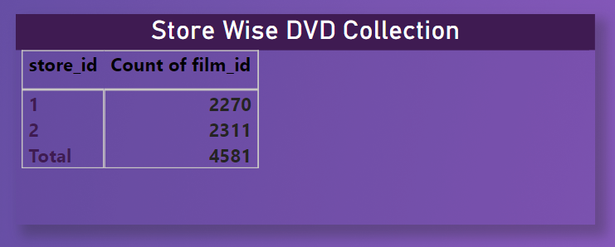
What is the distribution of staff by employment duration?
NOTE: There is no relevant data available in the given dataset to derive insight for the above problem statement. To find out staff performance we need data like customer feedback based on staffs, sales by staff, payment collection by staff, employment duration, working hours, etc.
So, I have derived the DVD collection for each store.
INSIGHT: Store 2 has roughly 2% more DVDs in inventory compared to store 1.

Slide 11
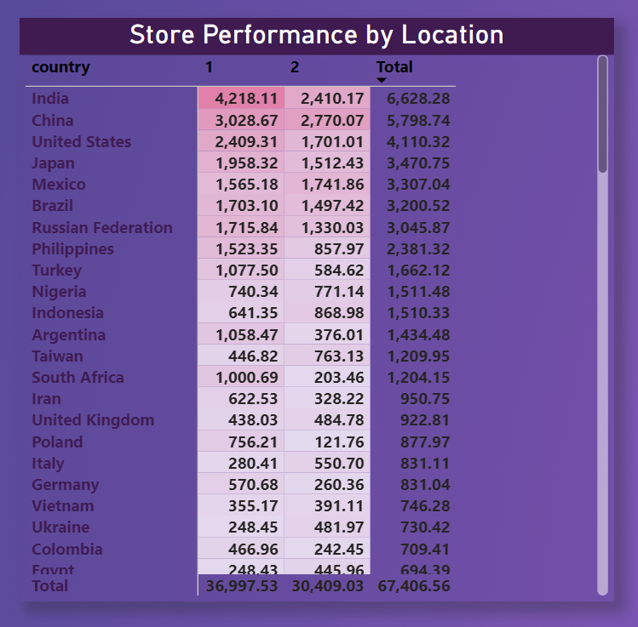
How does the store performance vary by location?
INSIGHT:
Store 1 performs better than the store 2 by roughly 18%. Also in some countries like India, Germany, South Africa, Colombia total revenue generated by store 1 is much higher than revenue generated by store 2.
CONCLUSION:
Store 1's superior performance and the variations in revenue in specific countries suggest that there may be opportunities for improvement in both stores. Understanding the reasons behind these differences and implementing effective strategies can lead to overall growth and increased profitability for the business.

Slide 12
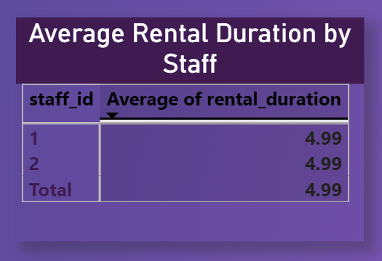
What is the average rental duration by staff member?
INSIGHT:
The average rental duration by staff member came out to be 4.99 which indicates that the average time one movie is rented is for 5 days.
CONCLUSION: The average rental duration of 5 days suggests that customers prefer relatively short rental periods. This information can inform inventory management, pricing strategies, and customer service practices to better cater to customer preferences and potentially increase customer satisfaction.

Slide 13
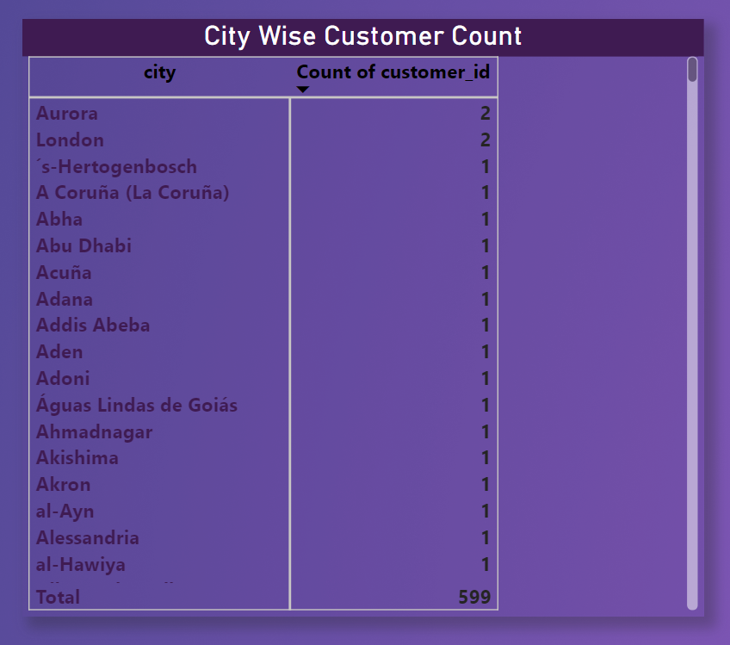
What is the distribution of customers across different cities?
INSIGHT:
Only 2 cities Aurora and London has two customers else every other city has only 1 customer.
CONCLUSION:
The uneven distribution of customers across different cities suggests that the company has both untapped opportunities and potential challenges. It should consider city-specific strategies and market analysis to optimize its global presence and improve customer distribution in various locations.

Slide 14
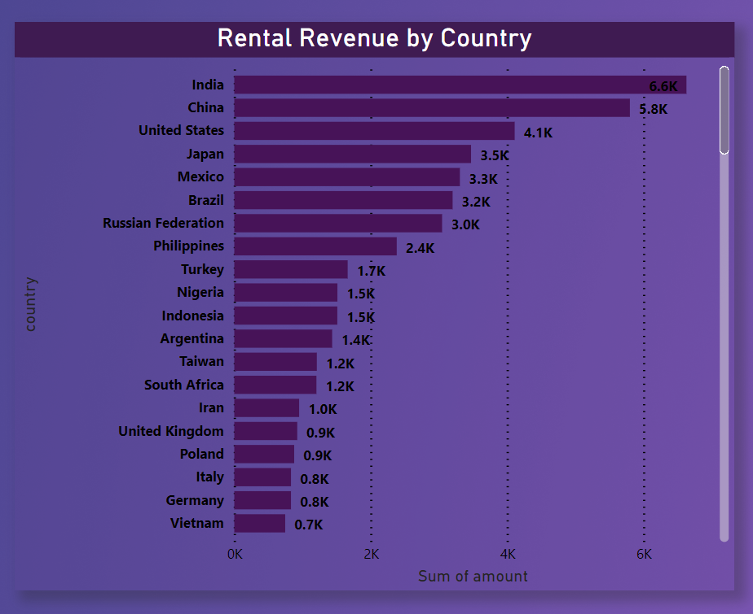
How does the rental revenue vary by country?
INSIGHT:
India is the highest revenue generating country followed by China, United States, Japan etc.
CONCLUSION:
Rental revenue varies significantly by country, with India, China, the USA, and Japan emerging as the top revenue generators. The company boasts a diverse global customer base, presenting market opportunities and challenges. To optimize revenue, it's crucial to tailor strategies to understand local customer preferences and adapt marketing and pricing accordingly. Competitive landscapes vary, requiring careful analysis. Localization efforts should be considered to address regional nuances

Slide 15
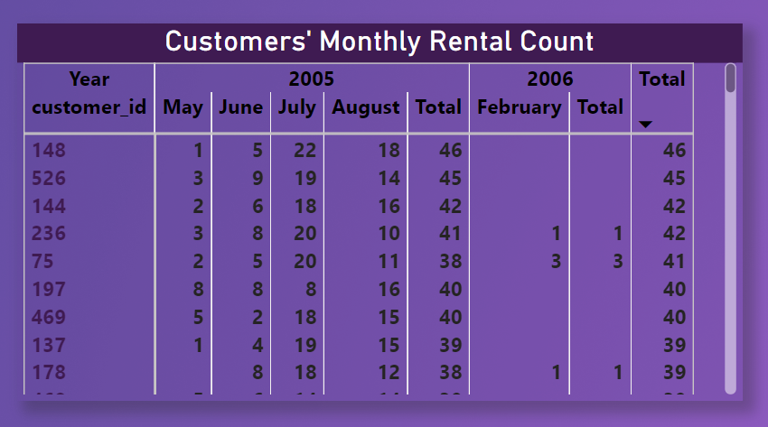
Which locations have the highest and lowest customer ratings?
NOTE: There is no relevant data available in the given dataset to derive insight about customer rating. Hence, the given problem statement cannot be solved.
So, I have calculated customers monthly rental pattern.
INSIGHT: After sorting the result set in descending order of rental count it is clear that some of the high value customers didn’t make any transaction in 2006.
CONCLUSION: We have to take customer feedback, do proper marketing to get back valuable customers. Thus the overall sales can be improved.

Slide 16
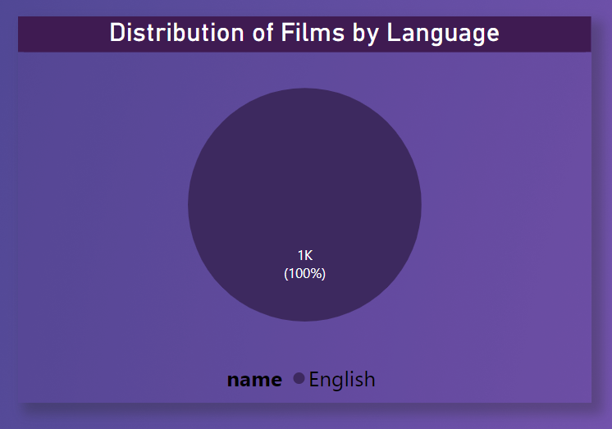
What is the distribution of films by language?
INSIGHT:
Though they there are six languages in the given data set table languages but all the films in the film table are in one language that is English. Hence as the asking of the given problem statement distribution of films by language, the report generated is that 100% of the movies are in English language.
CONCLUSION: The entire film collection in the dataset is exclusively in the English language, representing 100% of the movies. This suggests a lack of language diversity in the available films, which may limit the company's ability to cater to a broader international audience with different language preferences. To attract a more diverse customer base and expand market reach, it may be beneficial to consider acquiring or offering films in a variety of languages.

Slide 17
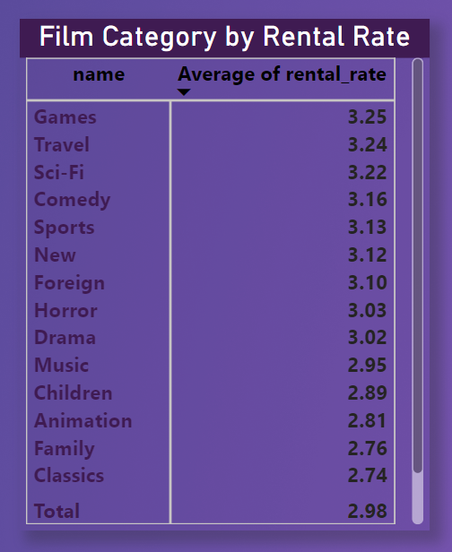
Which film categories have the highest rental rates?
INSIGHT:
Games category films have the highest average rental rate followed by travel and sci-fi movies.
CONCLUSION:
The data reveals that certain film categories, specifically "Games," "Travel," and "Sci-Fi," command higher average rental rates. This could indicate that these categories are particularly popular or in demand among customers, which presents an opportunity to maximize revenue. Additionally, understanding the factors driving the popularity of these categories can further inform content acquisition and customer engagement efforts.

Slide 18
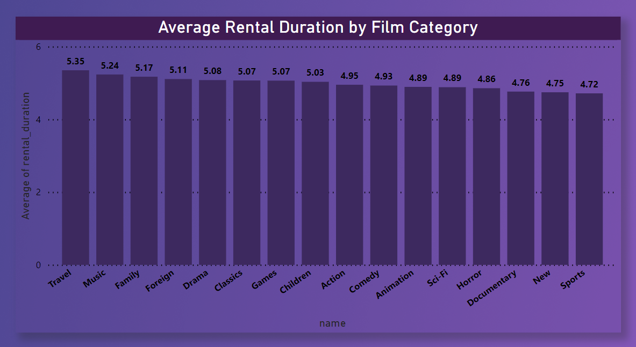
How does the average rental duration vary by film category?
INSIGHT:
Certain film categories like Travel, Music, Family etc. have higher rental duration than others. And films of news & sports genres have least rental duration.
CONCLUSION:
Analyzing this variance can provide insights into customer preferences and guide inventory management decisions for a rental business.

Slide 19
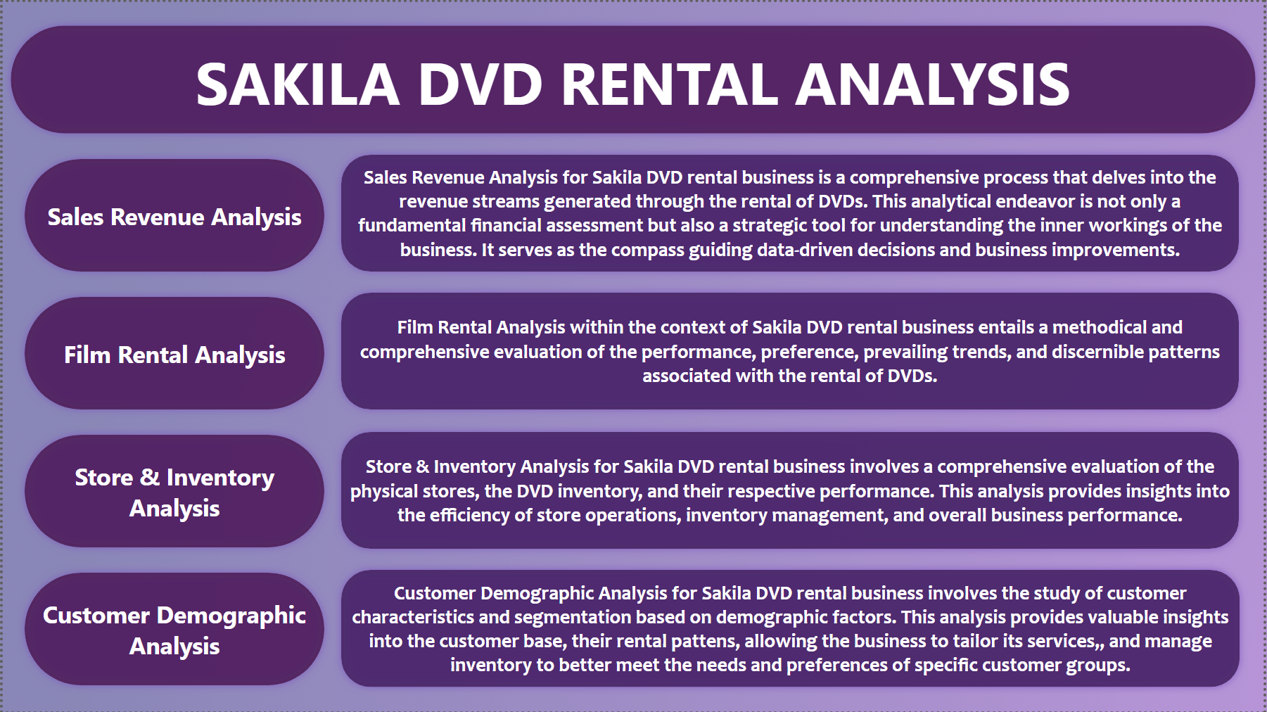

Slide 20
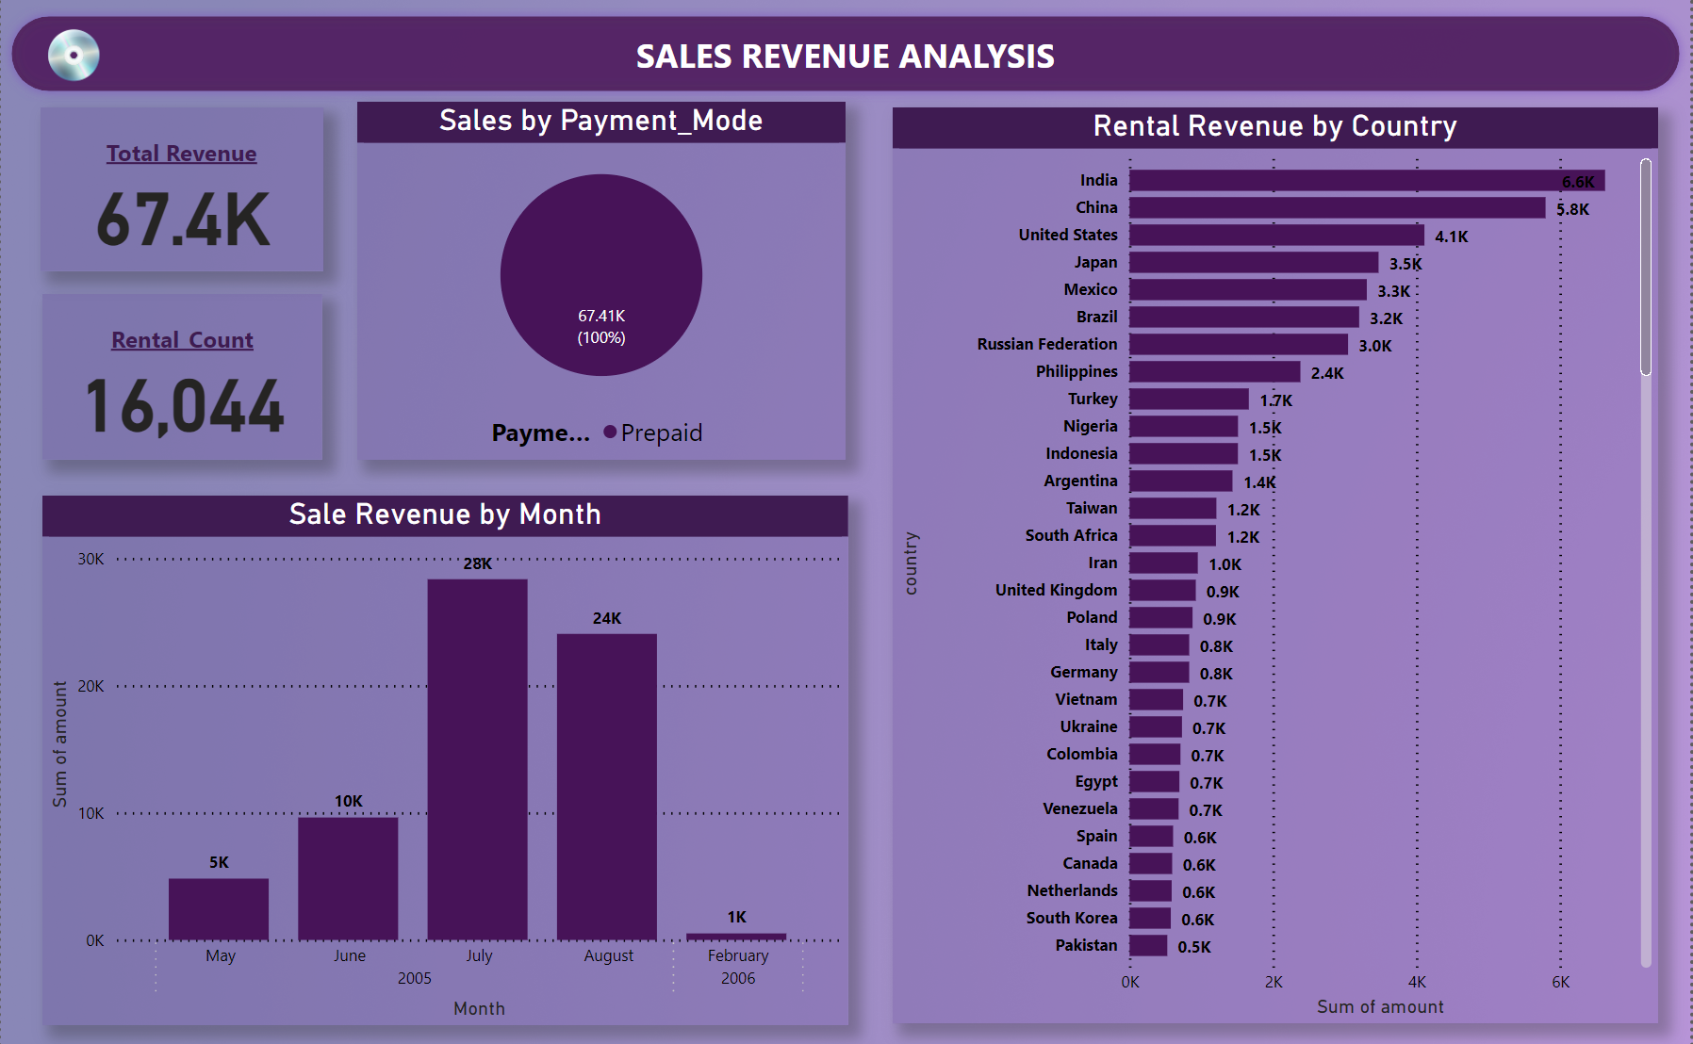

Slide 21
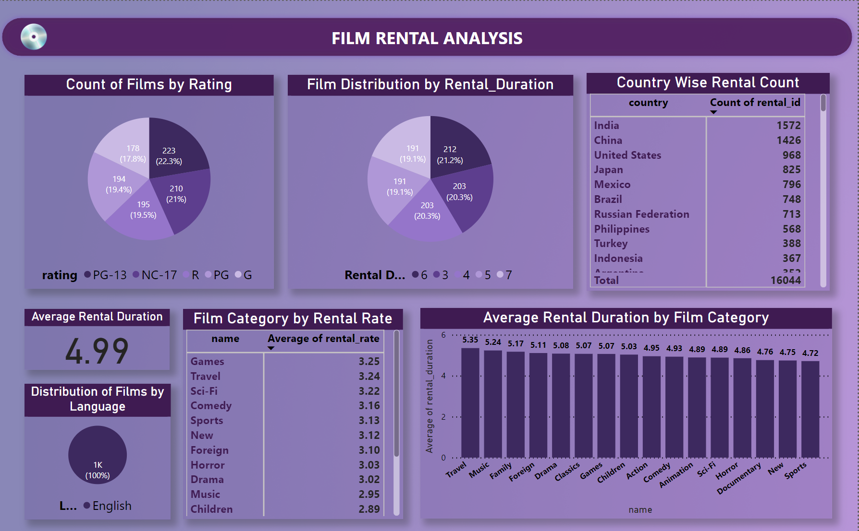

Slide 22
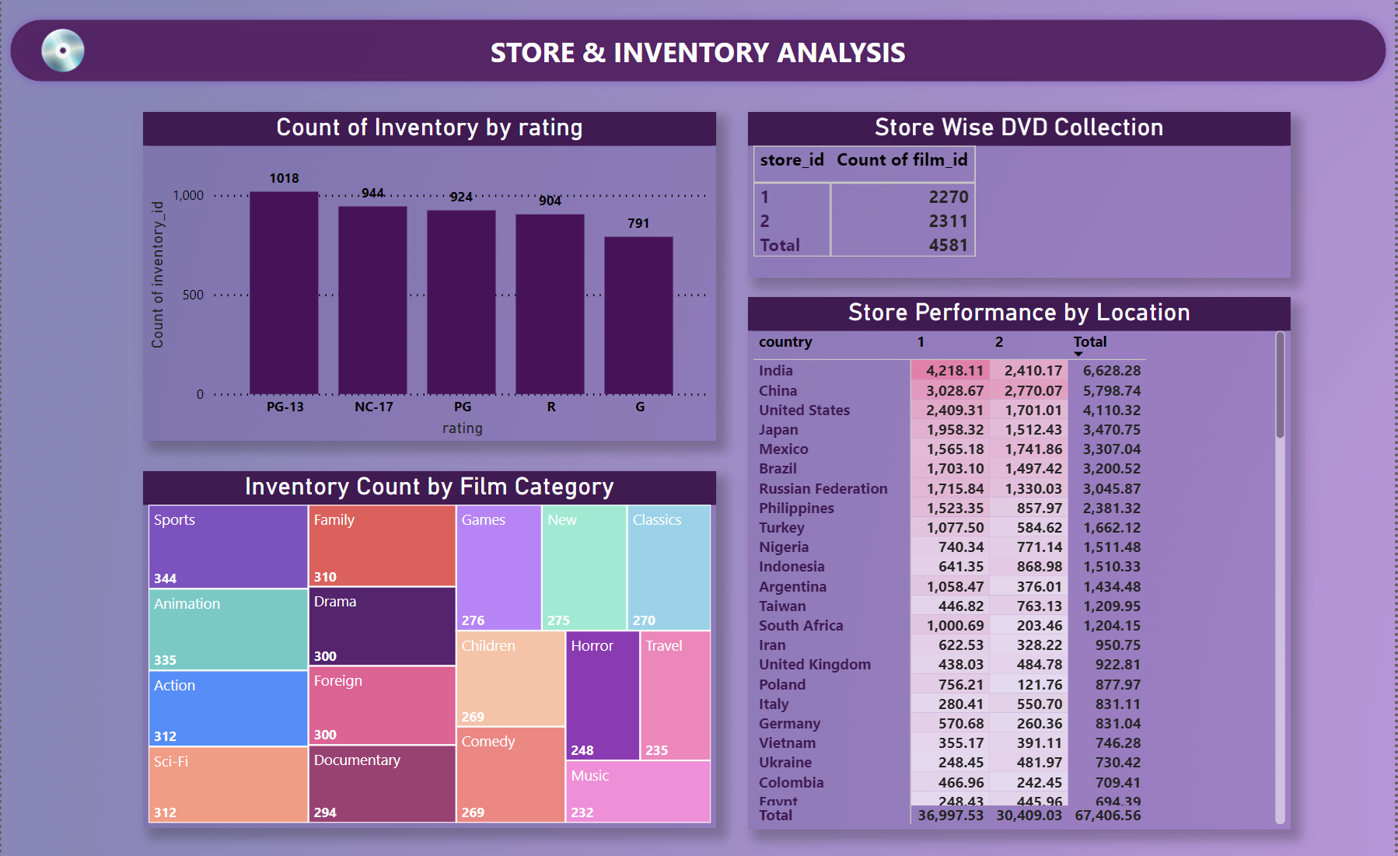

Slide 23
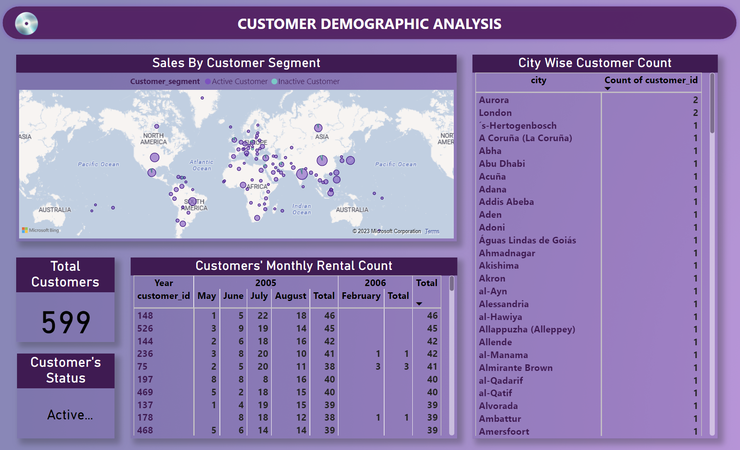

Slide 24
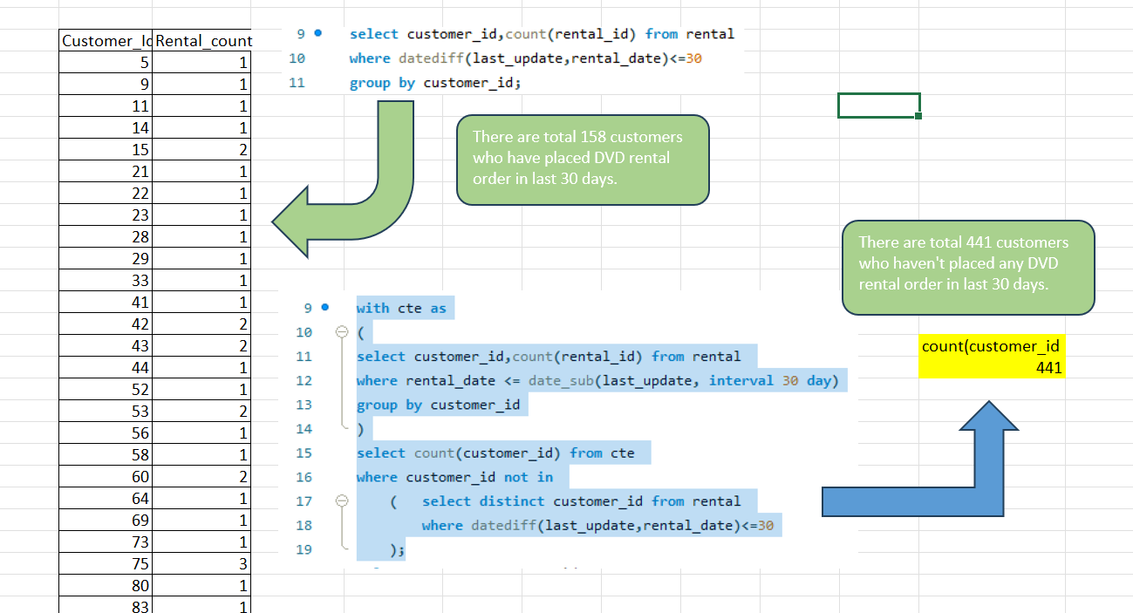
What are the purchasing patterns of new customers versus repeat customers?
EDA

Slide 25
Which films have the highest rental rates and are most in demand?
EDA
FILM TITLE | Category | Rating
BUCKET BROTHERHOOD | Travel | PG
FORWARD TEMPLE | Games | NC-17
GRIT CLOCKWORK | Games | PG
HOBBIT ALIEN | Drama | PG-13
JUGGLER HARDLY | Animation | PG-13
RIDGEMONT SUBMARINE | New | PG-13
ROBBERS JOON | Children | PG-13
ROCKETEER MOTHER | Foreign | PG-13
SCALAWAG DUCK | Music | NC-17
ZORRO ARK | Comedy | NC-17
INSIGHT:
“Bucket Brotherhood” has the highest rental rate and also it is most demanded.
Most of all high rented films are PG-13 rated.

Slide 26
Are there correlations between staff performance and customer satisfaction?
EDA
NOTE:
There is no relevant data available regarding staff performance or customer satisfaction in the given dataset. To understand staff performance, we need data like customer rating or feedback for staffs, store performance. Also, to get insight about customer satisfaction we need data on customer feedback.
So, I have gained insight about pricing impact on Rental Revenue which is one of the problem statements in my MECE breakdown of the given dataset.
INSIGHT:
The positive correlation between film rental rates and revenue suggests that businesses should focus on strategies that encourage more rentals, customer satisfaction, and effective marketing.

Slide 27
Are there seasonal trends in customer behavior across different locations?
EDA
INSIGHT:
Asia region has the highest number of movies rented in autumn (for northern hemisphere)or spring (for southern hemisphere) followed by the others region and Oceania region has the lowest number of movies rented.

Slide 28
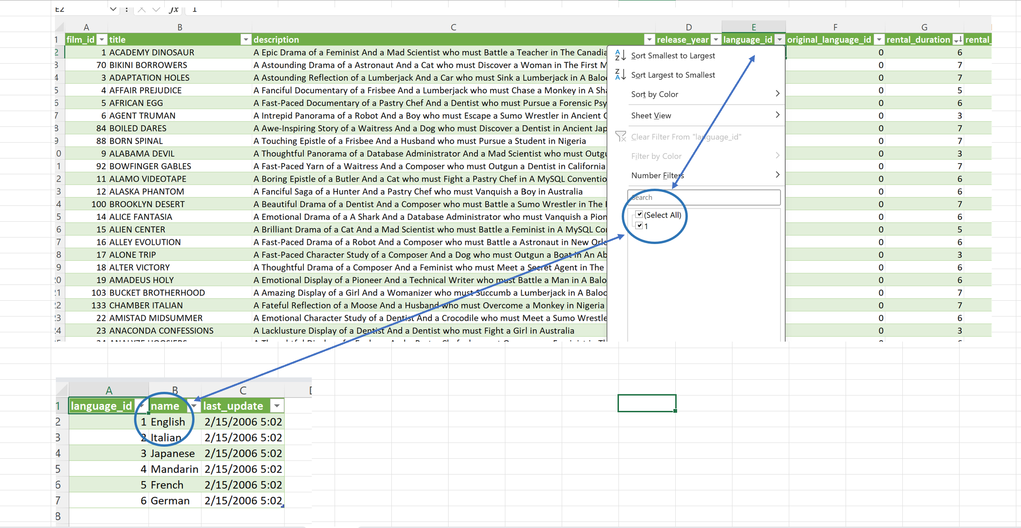
Are certain language films more popular among specific customer segments?
EDA

Slide 29
How does customer loyalty impact sales revenue over time?
EDA
INSIGHT:
The sales trend for the provided data shows a clear seasonal pattern with higher revenues from Summer to Autumn months (May to August) in 2005, but this pattern does not continue into 2006, where February's revenue is considerably lower. Further analysis and additional data are needed to understand the specific factors influencing this fluctuation and whether it represents a consistent trend over time.
CONCLUSION:
Customer loyalty drives sustained revenue growth. Loyal customers spend more, refer others, and require less marketing. They offer valuable feedback, support subscription models, and build a resilient brand. Long-term customer loyalty is essential for business success

Slide 30
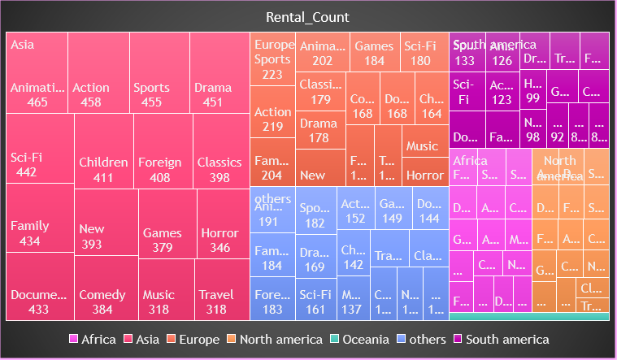
Are certain film categories more popular in specific locations?
EDA
INSIGHT:
Asia, North America and other regions inclined towards animation movies most where Europe, South America tends to watch sports movies and in Africa peoples like to watch foreign movies.

Slide 31
How does the availability and knowledge of staff affect customer ratings?
EDA
NOTE:
There is no relevant data available for customer rating. Also, after studying the data, I didn't get any insight of knowledge of staffs. So, I have gained insight about rating wise availability of films in each store which is one of the problem statements in my MECE breakdown of the given dataset.
Store_Id | Rating | Film_count
1 | PG | 444
2 | PG | 480
2 | G | 397
2 | NC-17 | 479
1 | G | 394
1 | PG-13 | 525
2 | PG-13 | 493
2 | R | 462
1 | NC-17 | 465
1 | R | 442
INSIGHT:
Both the stores have similar amount of DVD collection only varying by 2%. While store 2 has more R,NC-17 & PG rated films store 1 have upper hand while considering PG-13 & G rated films.

Slide 32
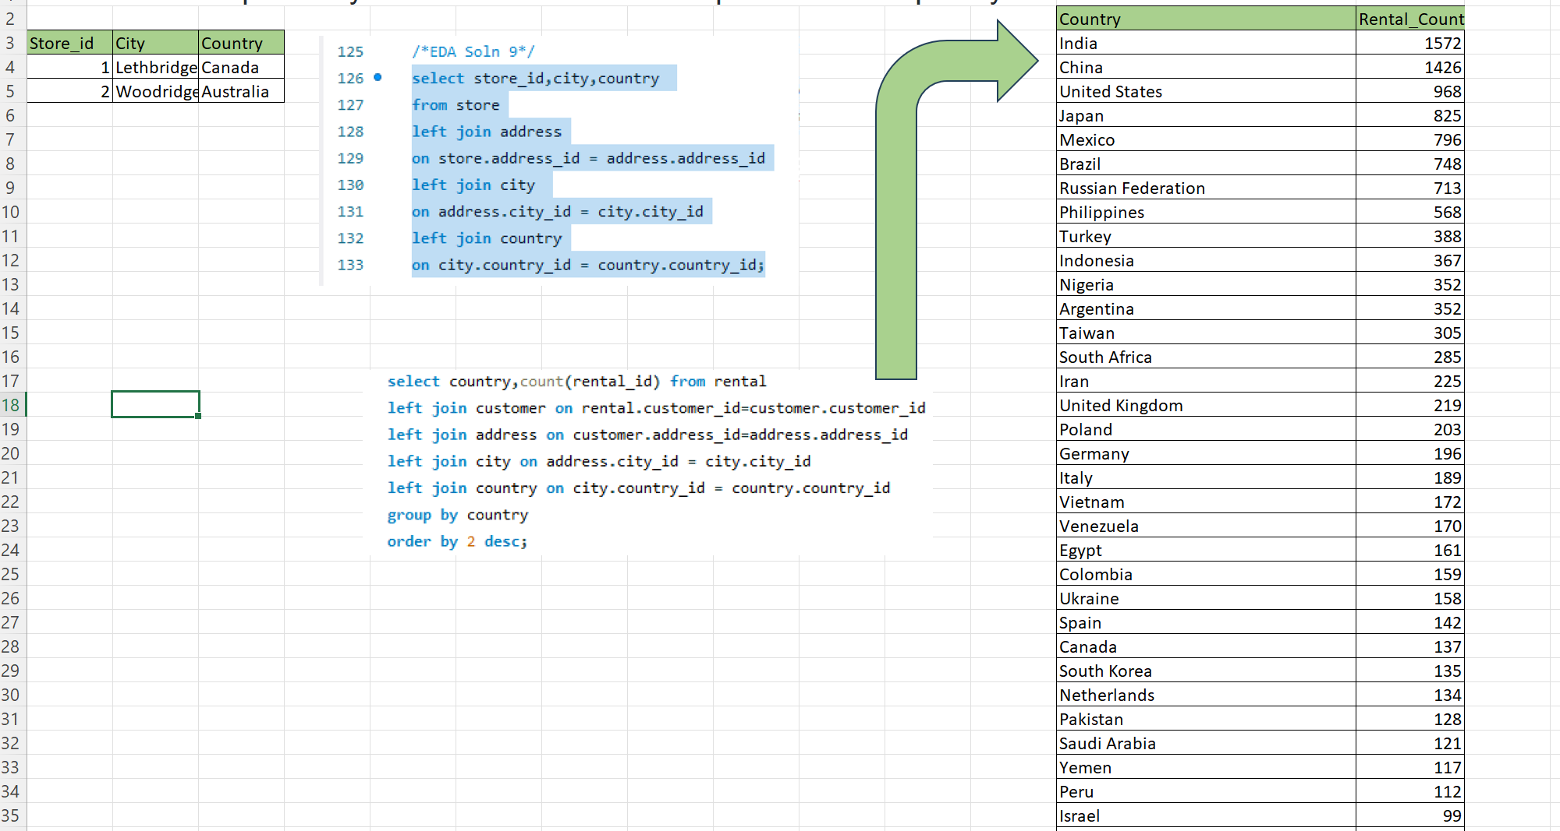
How does the proximity of stores to customers impact rental frequency?
EDA
NOTE:
proximity plays a critical role in enhancing customer convenience, encouraging repeat business, and increasing rental frequency, making it an important factor for businesses to consider in their location strategy.
But in the given dataset there is no correlation between stores location and customers rental frequency.

Slide 33
Do specific film categories attract different age groups of customers?
EDA
NOTE:
Specific film categories often attract different age groups of customers. For example, animated films may be popular among children and families, while action or thriller genres may appeal more to younger adults. Understanding the age group preferences for various film categories can help businesses target their audience more effectively and tailor their offerings to specific demographics
INSIGHT: Drama & Animation films are most popular among customer over 13 years.

Slide 34
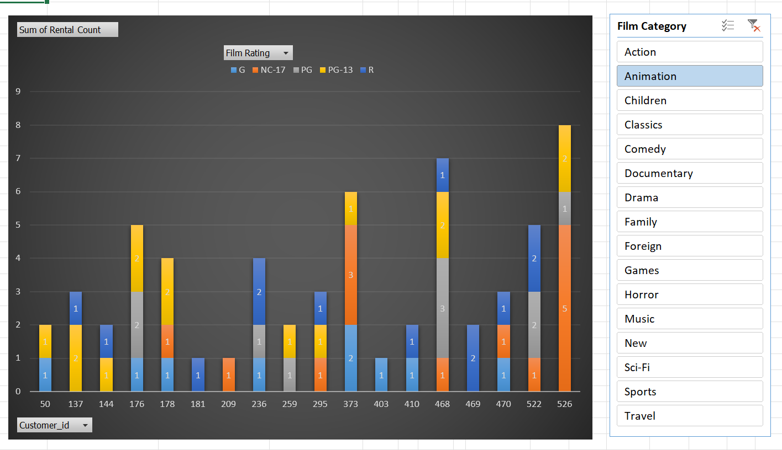
What are the demographics and preferences of the highest-spending customers?
EDA
NOTE:
High-spending customers tend to have higher incomes, value quality, appreciate personalization, prioritize convenience, and may favor luxury, exclusivity, and brand loyalty. Demographics vary but often include middle-aged to older individuals in urban areas.
INSIGHT: This analysis on customers preference based on film category & film rating will help to create a profile of highest-spending customers and tailor offerings to better meet needs and retain their loyalty.

Slide 35
How does the availability of inventory impact customer satisfaction and repeat business?
EDA
NOTE:
To find out availability of inventory we need data related to stock maintenance, customer request and to get insight of customer satisfaction we need data related to customer rating, review or feedback. But we don’t have any of these data in the given dataset. Hence, we cannot provide a particular solution for the given problem statement.
However, I have identified how many times customers have returned the product early or on time and also the times when customers have returned the rented DVDs lately. By this we can get a bird view understanding of how many times repeated business got impacted and about customers’ behavioral pattern.

Slide 36
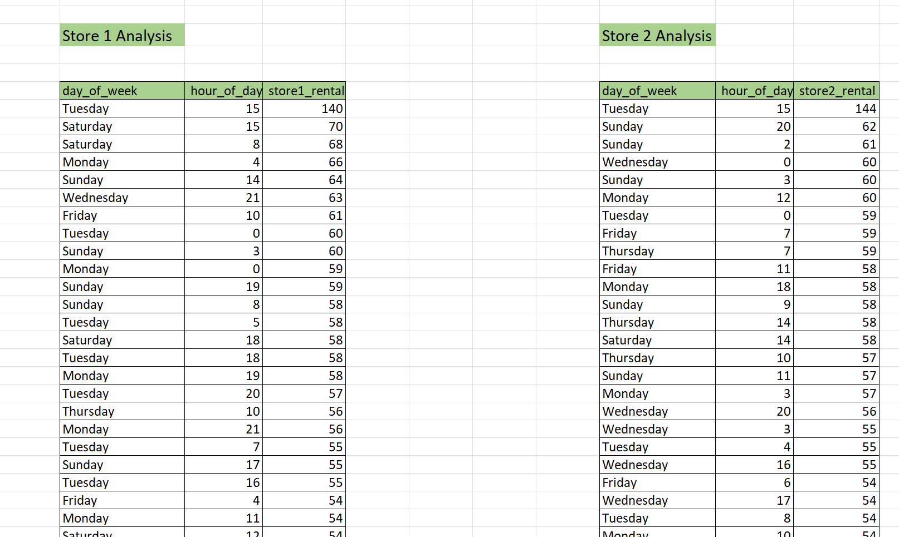
What are the busiest hours or days for each store location, and how does it impact staffing requirements?
EDA
INSIGHT:
Tuesdays 3:00 PM are the busiest hours of the whole week followed by Sundays input the stores. However, From the given dataset we can understand that there is only 1 staff in each store and there is no data provided for staff requirement or staff feedback or store feedback to gain insight about reequipments and pain points. Hence, second part of the given problem statement cannot be analyzed.

Slide 37
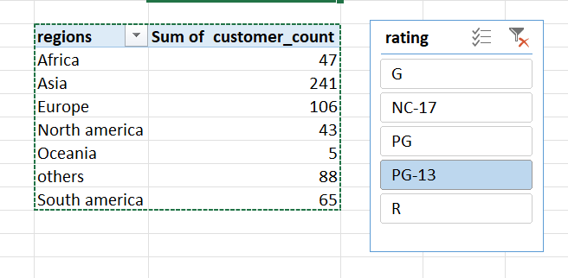
What are the cultural or demographic factors that influence customer preferences in different locations?
EDA
FINDINGS:
PG13 movies are most watched by customers of Asia.
INSIGHT:
Cultural and demographic factors, such as language, values, traditions, religion, income, age, education, gender, location, ethnicity, and local trends, significantly influence customer preferences in various locations. Understanding and adapting to these factors is essential for effective business strategies.

Slide 38
How does the availability of films in different languages impact customer satisfaction and rental frequency?
EDA
NOTE:
In the given dataset all the films are in English language and there is no rating or feedback table for customers. Hence we cannot be able to find solution for the given problem statement.
So, I have gained insight about the co-relation between the length of Films and number of times rented.
INSIGHT:
Rental count of films are increasing as the film length increases. This trend predicts Customer Preferences, Inventory Management, Pricing Strategy, Content Acquisition.

Slide 39
CONCLUSION
In conclusion the dashboard offers valuable insight, guides business improvement, facilitate data driven solutions and enhance the overall understanding of rental stored operations. By leveraging these insights rental stored owners can make informed decision optimize film inventory improve customer satisfaction and achieve sustained success in the competitive rentals store market.
By analyzing customer segmentation, film performance, store & inventory, staff productivity the dashboard will help rental store owners to focus on areas that requires improvement.

Slide 40
ACKNOWLEDGEMENT
I Would like to express my sincere gratitude to all those who contributed to the successful completion of this project. Firstly, I extend my gratitude to the creator of Sakila DVD rental store dataset for providing this valuable resources, which served the foundation for analysis. Secondly I would like to thank AccioJob for providing me the platform to upskill my knowledge in Data Analytics. Then I would like to thank Mayank sir, Snehanjan sir, Deepak sir, Shiraj sir, Anshul sir, Jay sir for their hand holding support to teach me MS Excel, SQL, Power BI, Problem Solving & Statistics. Also thank you Shiraj sir for being a constant support during each step of the project starting from project overview to how to deal with the problem statements and various challenging situations while solving EDA & Power BI report.
Finally I would like to acknowledge Acciojob DA batch 3 manager Ammar sir to constantly boasting up my confidence, communication skills, presentation skills for successful completion of this project.

Slide 41

THANK YOU

